Slide 1
Hate crime in New York
Week 8

Slide 2
Hate crime by county and bias type dataset
Hate crime dataset describes:
Offenses against any group of people
Offenses in each county in New York state
Types of offenses:
Targeting individuals
Targeting property

Slide 3
New York State’s Hate Crime Law
a person commits a hate crime when one of a specified set of offenses is committed targeting a victim because of a perception or belief about their race, color, national origin, ancestry, gender, religion, religious practice, age, disability, or sexual orientation, or when such an act is committed as a result of that type of perception or belief. These types of crimes can target an individual, a group of individuals, or public or private property.

Slide 4
Social justice
Minimize number of hate crimes
The right to live freely without being harmed because of
Color
Religion
Gender
Sexual orientation

Slide 5
Using dataset to benefit social good
Identifying counties with most hate crimes
Monitoring patterns of hate crimes in each county
Predicting hate crimes
Identifying key factors of hate crimes

Slide 6
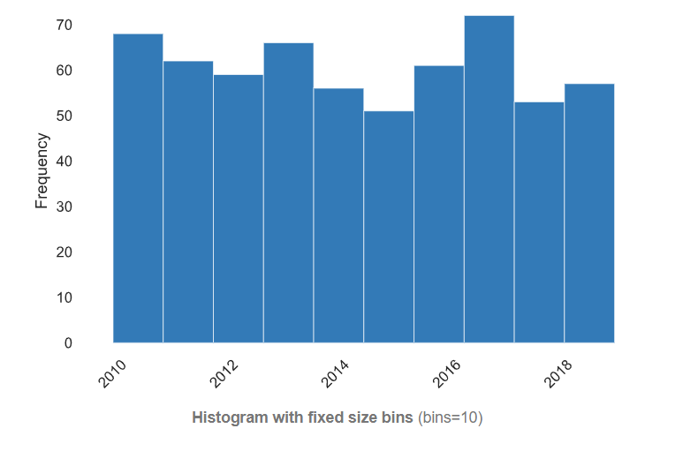
Visualization - EDA
Notes:
Number of hate crimes each year from 2010 to 2019

Slide 7
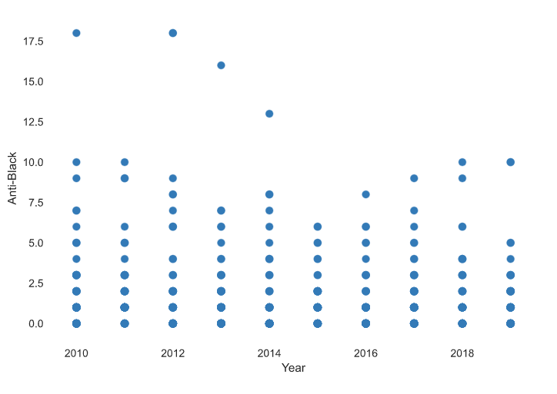
Notes:
Here we can see anti-black offenses are slightly fractulating with some outlires

Slide 8
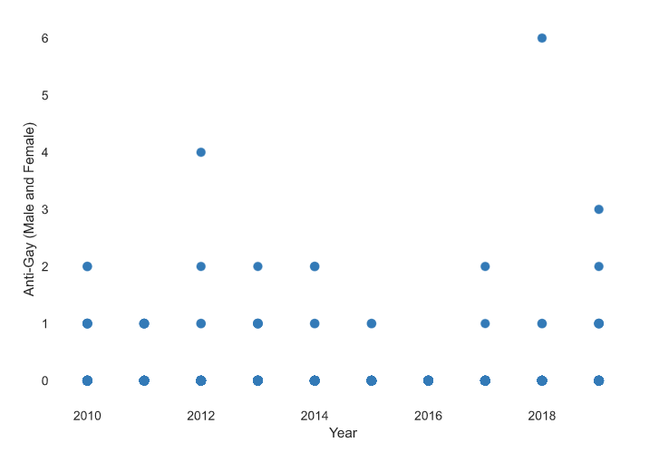
Notes:
Same observation as anti-black offenses, regardless of the total number of offenses

Slide 9
privacy and ethics issues
Privacy is protected in this dataset:
No personal data
All data are categorized by the offense, year, and county
Ethical issues may occur when this dataset is misused to:
Support false claims
Misrepresent the data to serve a specific purpose.

Slide 10
Reference:
https://catalog.data.gov/dataset/hate-crimes-by-county-and-bias-type-beginning-2010

